Slide 1
Essential Education Experience (E3)
Cassandra Reed-VanDam
University Senate
March 20,2025

Slide 2
What is an Essential Ed Experience?
Upper division course, meant to be taken junior year
Prepares our students for an ever-changing, dynamic, and diverse world. These active, hands-on experiences expand students' interactions with the greater society beyond the traditional classroom.
The experience is designed to increase students' social awareness, global understanding, and cultural competencies in a way that fosters lifelong global citizenship through their personal and professional lives.
Addresses the Contribute/Transform Learning Goal (Engage in Civic Life, Innovate Solutions, Create)

Slide 3
Types of E3s
Course with a significant civic engagement or service learning component
Example: SS4700 Communities and Research
Students research a community-identified issue or topic of concern, share results with partners
Planned immersive experience, study away
Example: FW3114 Sustainability in Sweden
3-week, interdisciplinary study abroad program
Course that leverages student-driven experiences, leadership roles, or philanthropic activities (a “wrap-around” course).
Example: ENG4070 Peer Mentoring Practicum
LEAP Leaders

Slide 4
Required Elements
Experiential Learning
Regular Critical Reflection
Interdisciplinary Approaches - SHAPE* Disciplines
Teach Best Practices and Ethical Standards
Showcasing Student Work in ePortfolio
*Social Sciences Humanities & the Arts for People and the Economy/Environment

Slide 5
ePortfolio
The ePortfolio is a vehicle for students to tell their story about their experience in the course, their life, and other courses and the way those aspects might impact future courses, their professional life, and their perspectives.
Templates and reflection prompts will be provided to E3 faculty members.
*Instructors are not required to incorporate the ePortfolio component in AY2025-2026

Slide 6
What does not count as an E3?
Major capstone courses
Why? Major restricted
The Enterprise Program as a whole
Why? Not grounded in a SHAPE discipline
Summer co-ops
Why? Projects are focused on disciplinary knowledge
Students just volunteering with an organization and getting credit for it
Why? No curricular framework
Reading and discussion-based course about pressing social issues
Why? Not hands-on

Slide 7
Rollout & Expected Seat Capacity
Planning for full implementation AY 2027-2028
AY25-26 25% capacity = 225 - 375 seats
AY26-27 50% capacity = 450 - 750 seats
AY27-28 100% capacity = 900 - 1500 seats
For next year, there are ~500 E3 seats available just based on what has already been approved
We will need about 28 sections/semester by full implementation
If interested in developing an E3, fill out this Interest Form or reach out to me

Slide 8
E3 Fellows
Members
Ann Hardin - College of Business
Sarah Bell - Humanities
Richard Canevez - Humanities
Jenni Nance - Humanities
Matt Seigel - Humanities
Kedmon Hungwe - Psychology & Human Factors
Angie Carter - Social Sciences
Mark Rhodes - Social Sciences
Sarah F Scarlett - Social Sciences
Projects:
Community partnership materials
Pedagogical resources
Workload equity models

Slide 9
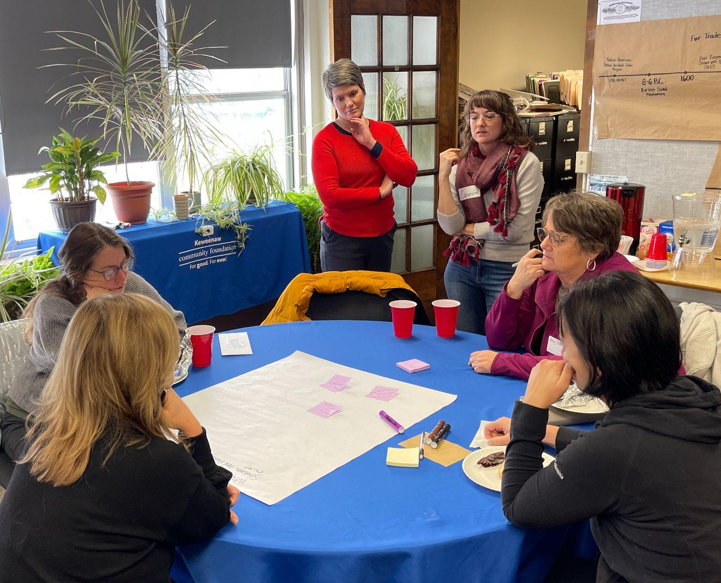
Community Focus Groups
Partnered with the Keweenaw Community Foundation
Hosted 5 Focus Groups in January
Over 50 participants attended (governmental agencies, non profits, small businesses, Michigan Tech faculty & staff)
Overall, partner organizations were very excited about this possibility but identified a need for clear structure

Slide 10
Community Focus Group Findings
Major Concerns
Limited capacity & resources of partner organizations
Scheduling/timing mismatch
Lack of transportation
Student professionalism & accountability
Cultural barriers, concerns about “savior complex”
Lack of clear structure for project/partnership development & matching
Proposed Solutions
Create clear structure for project matching & communication
Develop shared benefit agreements
Provide capacity building opportunities for CP
Offer many opportunities for relationship building
Develop E3s that are aligned with students’ interests and goals

Slide 11
Questions?
Cassandra Reed-VanDam
Essential Education Experience Manager
cmvandam@mtu.edu

